Slide 1
CS460 - Senior Design
Team 5 – Virtual Reality Research & Development
Daniel Johnson
T. Avery Eich
Asad Ashur

Slide 2
Project statement
Virtual Reality technology and tools have become highly accessible to small teams of software engineers and artists. These teams can now produce significantly immersive experiences without the need to adopt esoteric design and implementation techniques. In light of these advancements, our team performed research into the content developers have produced over the past two years, and will utilize this research to design and implement a fully-featured VR experience.

Slide 3
outline
Hardware & Software
Research Methods
Data Entry and Analysis
Implementation Plan (Future)

Slide 4
Hardware & software
T. Avery Eich

Slide 5
Hardware considerations
HTC Vive
360º View
Position and Hand Tracking
Oculus Rift
Head Tracking
Not 360º View

Slide 6
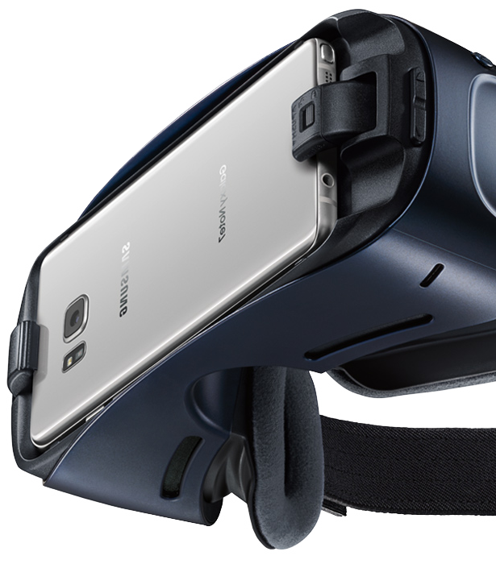
Why Gear VR?
Mobile
Affordable
360º View
Oculus SDK

Slide 7

Software
Oculus, Android, & Unity
Solid Codebase and Documentation.
Vibrant Development Community
Cross-Platform Support.

Slide 8
Research Methods
Asad Ashur

Slide 9
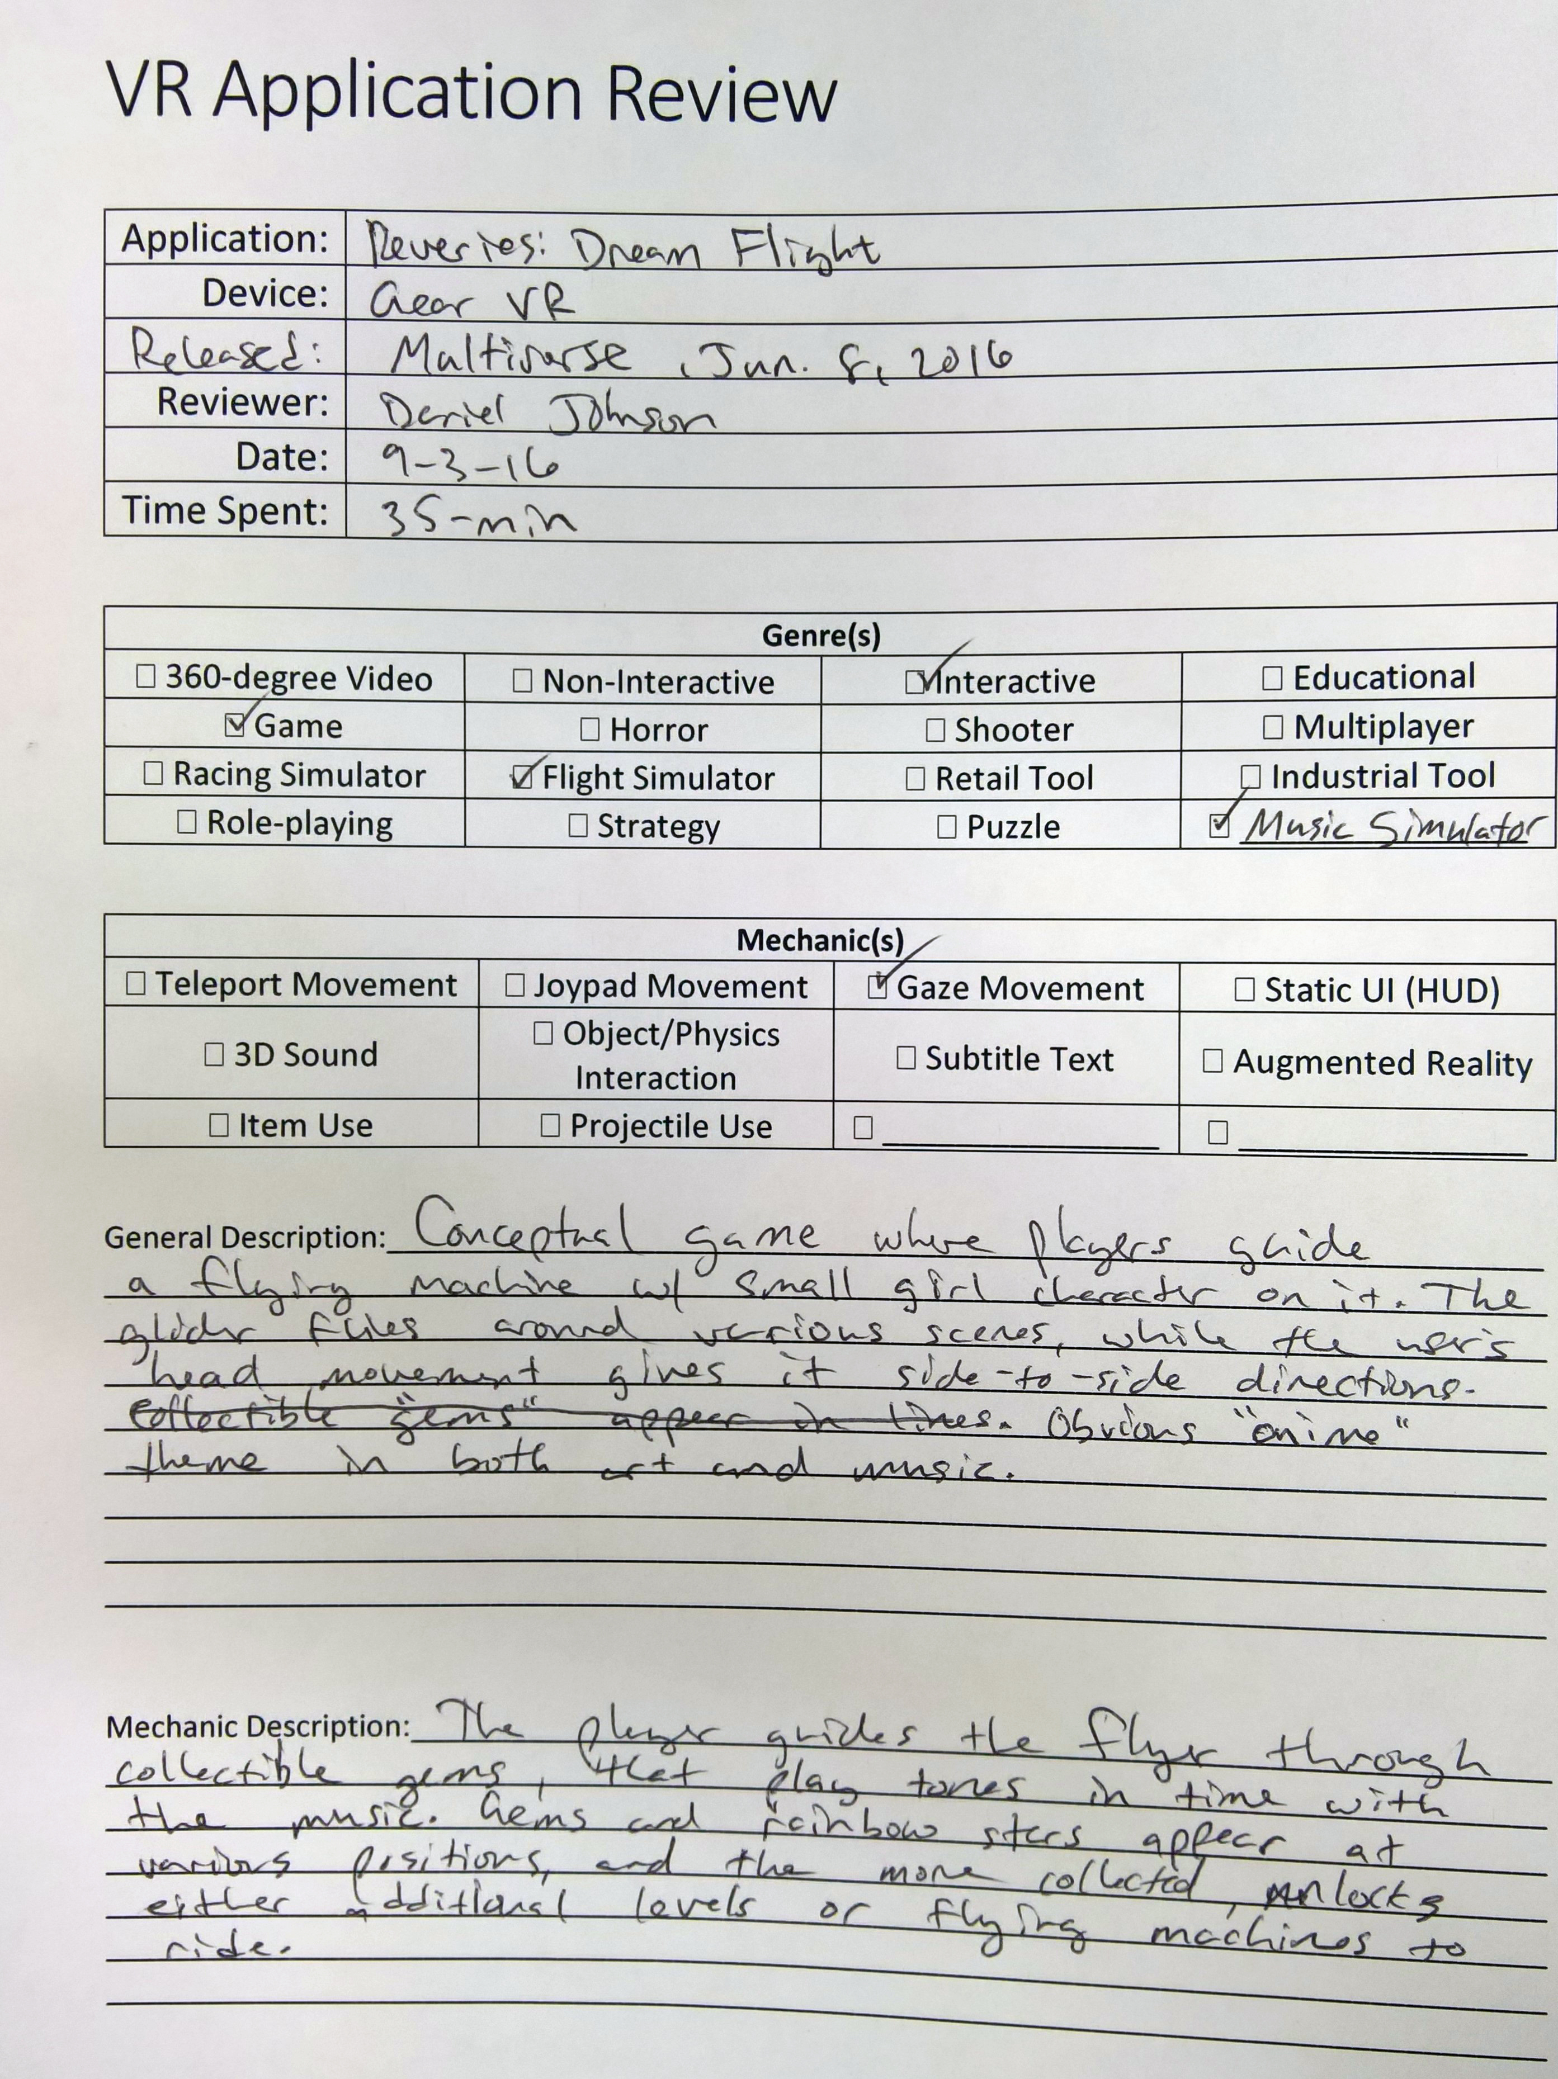
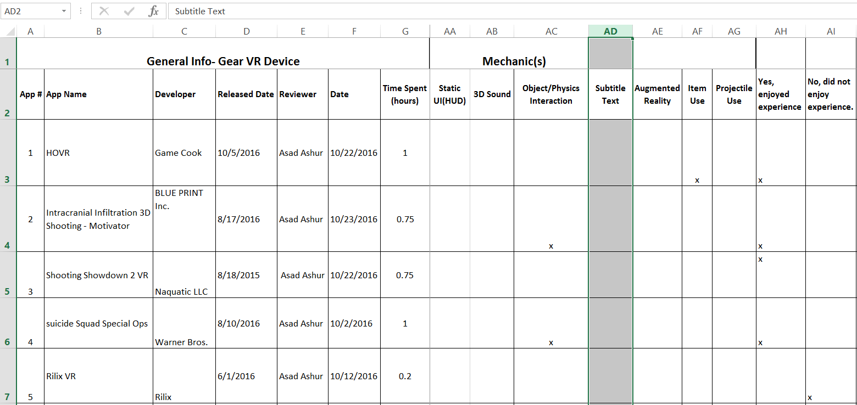
Research Data Collection
Manual Entry of Data (paper/excel)
Collected from application “review” process.
Included application metadata and subjective review.

Slide 10

Research Data Storage
Desired additional visibility of data, including analysis and relation.
Developed Entity-Relationship Diagram based on the application characteristics.

Slide 11
Sample Evaluation
App Name | Pros | Cons | Rating
HOVR | Objects & obstacles Jump and slide on rails Ride skateboard | Nitro does not fly Does not have many controls Does not move in all directions | 4.5
Intracranial Infiltration 3D Shooting - Motivator | Simple and easy to play Being able to upgrade the ship with money There are levels Ion beam attack | Limited direction movement Two items only Few # of enemies | 4
Added subjective review information
To track popularity of apps within the design group
Organized pros/cons to see how we might improve on mechanics for our own application.

Slide 12
Data Application Development
Daniel Johnson

Slide 13

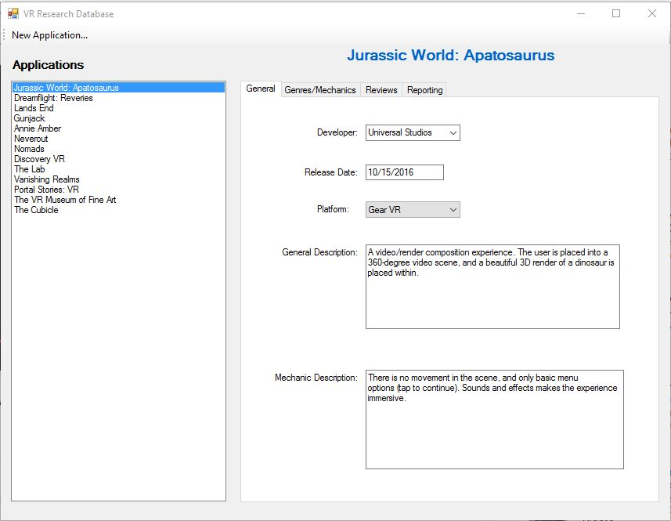
Data Entry and Collection
Data-driven desktop application developed to facilitate data entry and organization.
Microsoft Windows Forms
GitHub

Slide 14
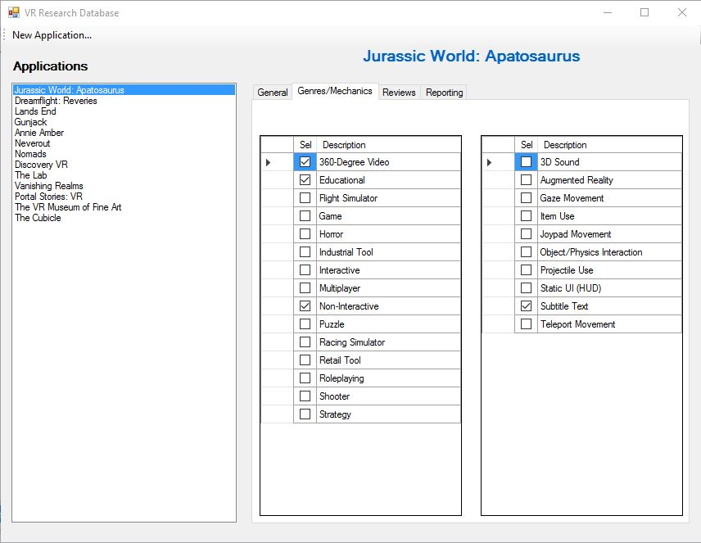
Data Lookup and Display
Find specific attributes for reference during development.
Keep track of review metrics for reporting.

Slide 15
Conclusion
Current Tasks
Research Oculus Rift project deployment.
Research integration of AR plugin (Vuforia) to gain motion tracking with Gear VR.
Fully develop application implementation plan to be executed second semester.
Use research data and analysis to drive the application vision.

